Slide 1

Asynchronous Programming and
Collections in Dart
A Comprehensive Guide
Notes:
Hello everyone, welcome to our session on "Asynchronous Programming and Collections in Dart”., In this presentation we will delve into the world of advanced Dart programming, exploring powerful features and techniques that can take your coding skills to the next level. We'll cover asynchronous programming with Futures and Streams, data manipulation with Collections and Generics, advanced data structures, best practices and style guides, advanced features like mixins and extensions, performance optimization, and concurrency and multi-threading. Get ready to unlock the full potential of Dart and build exceptional applications!

Slide 2


Introduction
Asynchronous Programming:
Asynchronous programming is crucial for responsive apps.​
Dart offers powerful async features like Futures and Streams.​
Collections in Dart:
Collections are essential for managing data.​
Dart supports various collections like lists, sets, maps, and queues.​
Notes:
What is Asynchronous Programming?
Asynchronous programming is a way for a computer program to handle multiple tasks simultaneously rather than executing them one after the other.
Synchronous vs. Asynchronous:
Synchronous: Traditional code where each line executes one after the other, blocking the main thread until they finish. This can make your app unresponsive if waiting for something like downloading data.
Asynchronous: Code that launches an operation but continues executing other tasks without waiting for it to finish. This keeps the main thread free to handle other user interactions or tasks.

Slide 3

Asynchronous Programming in Dart
Futures​
Represent an asynchronous operation that eventually completes.​
Handle the result of the operation with .then or await.​
Use await to wait for the result to be available.​
Streams​
Represent sequence of data elements received asynchronously.​
Listen to the stream of data using methods like listen.​
Use async for loop to iterate over the stream elements.​
Notes:
Dart offers two main tools for asynchronous programming:
Future: Represents an ongoing computation that eventually produces a result. You can use await keyword within an async function to pause execution until the Future is complete. This lets you continue with other tasks without blocking the main thread.
Stream: Represents a sequence of asynchronous events delivered over time. Similar to Future, you can use await for loop within an async function to receive each event as it arrives. This is handy for tasks like continuously streaming data from a server.

Slide 4
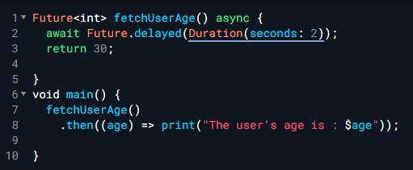

Example of Future
1. Asynchronous Function:
Fetch User Age() is an asynchronous function that will eventually return an integer (user's age).
It uses the async keyword to handle time-consuming operations without blocking the code's flow.
2. Simulating a Network Request:
await Future .delayed(Duration(seconds: 2)) creates a 2-second delay, acting as a placeholder for a network request.
The await keyword pauses the function's execution until the delay (or actual network request) completes.
Notes:
1. Asynchronous Function:
Fetch User Age() is an asynchronous function that will eventually return an integer (user's age).
It uses the async keyword to handle time-consuming operations without blocking the code's flow.
2. Simulating a Network Request:
await Future .delayed(Duration(seconds: 2)) creates a 2-second delay, acting as a placeholder for a network request.
The await keyword pauses the function's execution until the delay (or actual network request) completes.

Slide 5

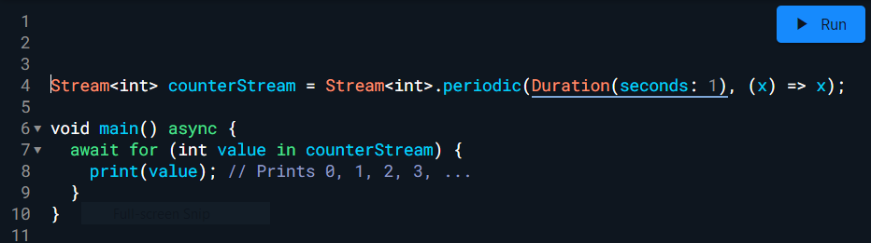
Example of Stream
Creating a Stream:​
Stream<int> counter Stream = Stream<int>.periodic(Duration(seconds: 1), (x) => x);​
Creates a Stream called counter Stream that emits an integer every second.​
Stream<int> specifies that the Stream produces integer values.​
2. Asynchronously Iterating over the Stream:​
await for (int value in counter Stream) { ... }​
Uses an await for loop to iterate over the elements of the Stream asynchronously.​
await for pauses execution until the next value is available from the Stream.​
Notes:
1. Creating a Stream:​
Stream<int> counter Stream = Stream<int>.periodic(Duration(seconds: 1), (x) => x);​
Creates a Stream called counter Stream that emits an integer every second.​
Stream<int> specifies that the Stream produces integer values.​
Stream .periodic() creates a Stream that generates events at regular intervals.​
Duration(seconds: 1) sets the interval to 1 second.​
(x) => x is a generator function that produces the values to be emitted (here, it simply returns the current counter value x).​
2. Asynchronously Iterating over the Stream:​
await for (int value in counter Stream) { ... }​
Uses an await for loop to iterate over the elements of the Stream asynchronously.​
await for pauses execution until the next value is available from the Stream.​
Each emitted value is assigned to the value variable within the loop.​

Slide 6
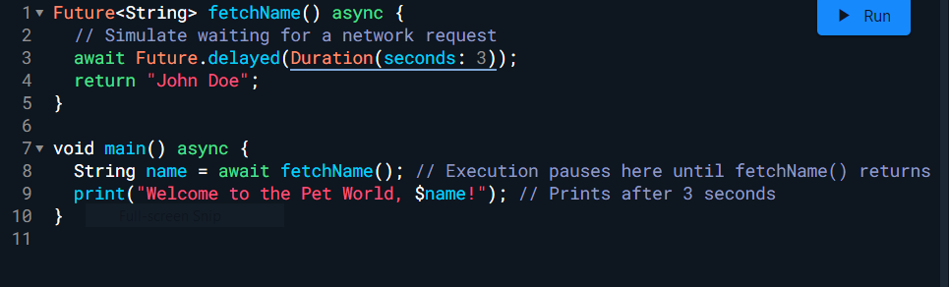
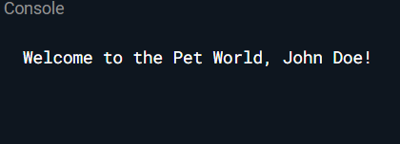
Async and Await
1.async:
Used to mark a function as asynchronous. This means the function might take some time to complete because it may be waiting for an external event, like a network request or user input.
When an async function is called, it immediately returns a Future object that represents the eventual result of the function.
2. await:
Used within an async function to pause the execution of the function until the awaited value is ready.
The awaited value can be anything that represents an asynchronous operation, such as another Future or a stream.
While the awaited value is being retrieved, the rest of the code in the async function doesn't wait.
Notes:
1. async:
Used to mark a function as asynchronous. This means the function might take some time to complete because it may be waiting for an external event, like a network request or user input.
When an async function is called, it immediately returns a Future object that represents the eventual result of the function.
2. await:
Used within an async function to pause the execution of the function until the awaited value is ready.
The awaited value can be anything that represents an asynchronous operation, such as another Future or a stream.
While the awaited value is being retrieved, the rest of the code in the async function doesn't wait. This allows other parts of your program to continue running normally.
Once the awaited value is available, await resumes the execution of the async function and assigns the available value to the variable following await.
Benefits of using async and await:
Makes asynchronous code easier to read and understand by mimicking the flow of synchronous code.
Reduces the need for nested callbacks or complex .then() chains, making code more concise and maintainable.
Improves the responsiveness of your app by allowing other parts of the program to run while waiting for asynchronous operations to complete

Slide 7
Collections in Dart​
Like any other programming languages dart doesn’t support arrays
Dart collections can be used as data structures like an array. ​
A collection is an object that represents a group of objects called elements.​
Iterables are a kind of collection.​
A collection can be empty, or it can contain many elements. ​
Depending on the purpose, collections can have different structures and implementations.​
Dart collections can be basically classified as:​
List​​
Set​ ​
Map​ ​
Queue​ ​
Notes:
An Iterable is a collection of elements that can be accessed sequentially.
In Dart, an Iterable is an abstract class, meaning that you can’t instantiate it directly. However, you can create a new Iterable by creating a new List or Set.
In Dart, an Iterable is an abstract class, meaning that you can’t instantiate it directly. However, you can create a new Iterable by creating a new List or Set.

Slide 8


Lists
Lists​
​
Lists are ordered collections of elements that can be accessed by index.​
The List class provides methods for adding, removing, and searching for elements.​
​
List in dart can be classified as:
Fixed Length List ​
Growable List​
Notes:
Lists​
​
Lists are ordered collections of elements that can be accessed by index.​
The List class provides methods for adding, removing, and searching for elements.​

Slide 9
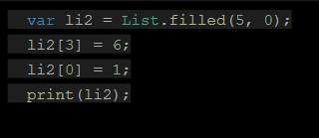
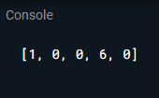
List in dart can be classified as:
Fixed Length List
In Fixed Length List the list’s length cannot be changed at run-time.
These list’s are defined with a specific length.
Notes:
Fixed Length List
In Fixed Length List the list’s length cannot be changed at run-time.
These list’s are defined with a specific length.

Slide 10
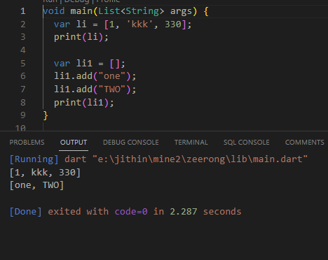
Growable List
Growable List
In Growable List the list’s length can be changed at run time.
The following example shows how to create a list of 3 elements and another example which creates a zero-length list using the empty List() constructor.
The add() function in the List class is used to dynamically add elements to the list.
Notes:
Growable List
In Growable List the list’s length can be changed at run time.
The following example shows how to create a list of 3 elements and another example which creates a zero-length list using the empty List() constructor.
The add() function in the List class is used to dynamically add elements to the list.

Slide 11
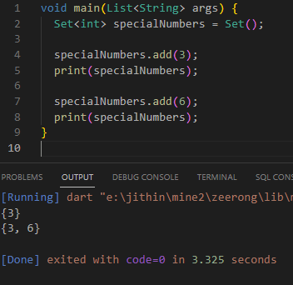
Set
Set represents a collection of objects in which each object can occur only once.
The dart :core library provides the Set class to implement the same.
Must be useful when the program doesn't want a object to be added twice.
Notes:
Set represents a collection of objects in which each object can occur only once.

Slide 12

Maps​​
Maps​​
​
Maps are collections of key-value pairs.​​
The Map class provides methods for associating keys with values and retrieving values by key.
Maps can be declared in two ways :
Using Map Literals
Using a Map constructor
Notes:
Maps​​
​
Maps are collections of key-value pairs.​​
The Map class provides methods for associating keys with values and retrieving values by key.

Slide 13
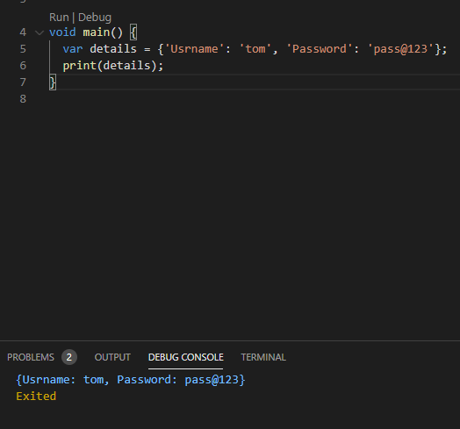
Maps can be declared in two ways :
Using Map Literal
Just like we declare list using var keyword, we can also use var for declaring Maps.
The main difference between declaration is, for declaring list we use [](square brackets), but to declare maps we have to use {}(curly braces).
for declaring list use [ ]
for declaring map use {}
Notes:
Using Map Literal
Just like we declare list using var keyword, we can also use var for declaring Maps.
The main difference between declaration is, for declaring list we use [](square brackets), but to declare maps we have to use {}(curly braces).
for declaring list use [ ]
for declaring map use {}

Slide 14
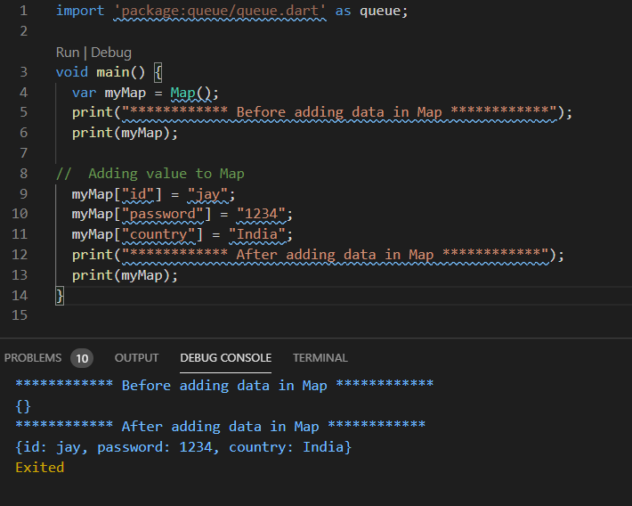
Using Map Constructor
Using Map Constructor
For declaring Map we can also use Map() constructor.
It’s just which way you like.
There nothing wrong if you declare map using standard method.
Notes:
Using Map Constructor
For declaring Map we can also use Map() constructor.
It’s just which way you like.
There nothing wrong if you declare map using standard method.
A Map is a collection of data that is organized into key-value pairs. Any type of key and value can be used. It is a growable collection, which means it can shrink and grow in run-time.
To declare a Map we can use the Map() constructor.

Slide 15
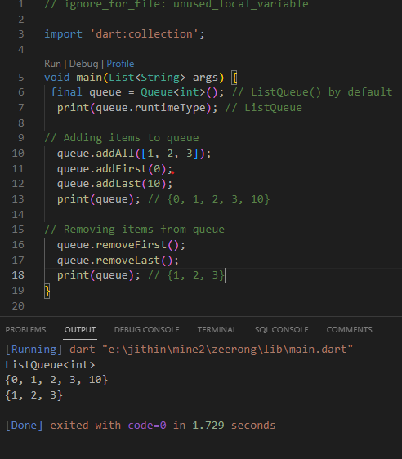
Queue
A Queue is a collection that can be manipulated at both ends.
Queues are useful when you want to build a first-in, first-out (FIFO) collection.
The values are removed / read in the order of their insertion.
The add() function can be used to insert values to the queue.
This function inserts the value specified to the end of the queue.
Notes:
What are Queues?
Queues are useful when you want to build a first-in, first-out (FIFO) collection.
The values are removed / read in the order of their insertion.
The add() function can be used to insert values to the queue.
This function inserts the value specified to the end of the queue.

Slide 16

Generics in Dart
Generics allow you to write code that is reusable and type-safe.​
Generic types are represented by type parameters that are declared with angle brackets (<>).​
Generic classes and methods can be used with different types by specifying the type arguments.​
Notes:
Generics with collections
This should only be done when you really need a collection containing many different types. If you know the intended type of a list's elements, you should specify that type within the angle brackets, which will allow the Dart analyzer to help you avoid errors:
Similarly, if you intend for a map to contain keys and values of a particular type, include them in the declaration:
With maps, the first type within the angle brackets constrains the map's keys while the second does the same for the map's values. It should be noted that Dart allows you to use any type for map keys, whereas in some languages only strings are allowed.

Slide 17
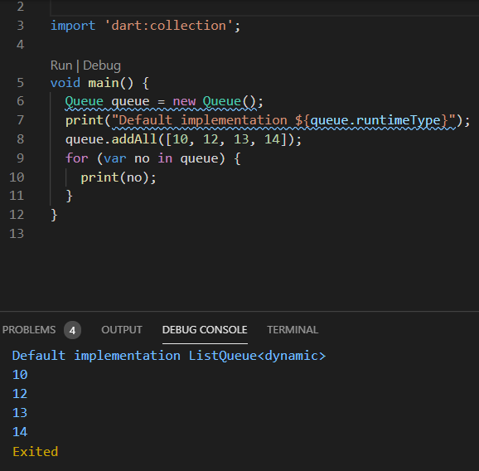

Effective Dart: Best Practices and Style Guide
Write clean, readable, and maintainable code.​
Follow consistent naming conventions.​
Use comments to explain complex code.​
Test your code thoroughly.​
Notes:
Write clean, readable, and maintainable code.​
Follow consistent naming conventions.​
Use comments to explain complex code.​
Test your code thoroughly.​

Slide 18
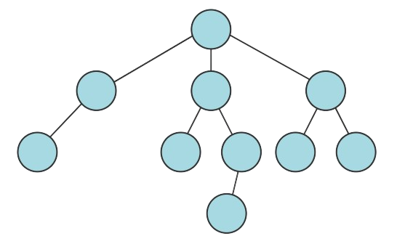
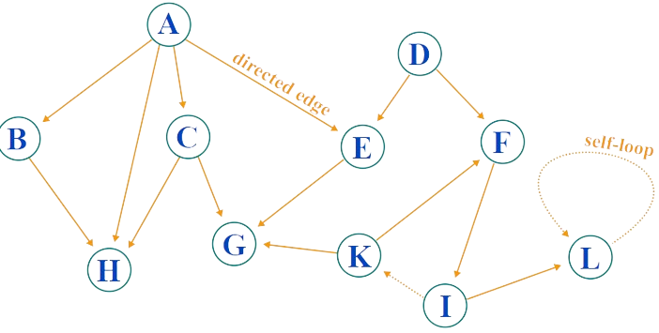
Advanced Data Structures in Dart
Trees​
Trees are hierarchical data structures that consist of nodes connected by edges.​
​
Dart provides the Tree class for representing and manipulating trees.​
Graphs​
Graphs are collections of nodes connected by edges.​
​
Dart provides the Graph class for representing and manipulating graphs.​
Notes:
Trees​
Trees are hierarchical data structures that consist of nodes connected by edges.​
​
Dart provides the Tree class for representing and manipulating trees.​
Graphs​
Graphs are collections of nodes connected by edges.​
​
Dart provides the Graph class for representing and manipulating graphs.​

Slide 19


Performance Optimization in Dart
Identify and eliminate performance bottlenecks.​
Use efficient data structures and algorithms.​
Optimize code for the target platform.​
Notes:
Use efficient data structures and algorithms.​
Optimize code for the target platform.​

Slide 20


Advanced Dart Features and Techniques
Mixins: Reuse code across classes.​
Extensions: Add functionality to existing classes without modifying their source code.​
Metaprogramming: Manipulate code at runtime for powerful capabilities.​
Notes:
Extensions: Add functionality to existing classes without modifying their source code.​
Metaprogramming: Manipulate code at runtime for powerful capabilities.​

Slide 21
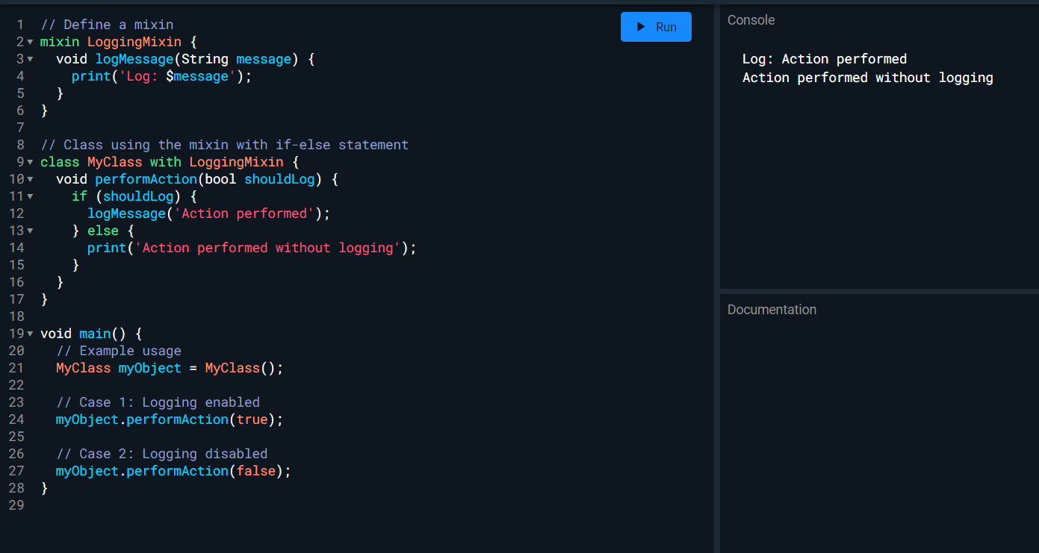

Slide 22
In this example:
We have a Logging Mixin, mixin that provides a log Message method.
The My Class, class uses the mixin with the with keyword.
The perform Action method in My Class takes a Boolean parameter should Log and uses an if-else statement to conditionally call the log Message method based on the value of should Log.
In the main function, we create an instance of My Class and demonstrate two cases, one with logging enabled and one with logging disabled.
Notes:
The perform Action method in My Class takes a Boolean parameter should Log and uses an if-else statement to conditionally call the log Message method based on the value of should Log.
In the main function, we create an instance of My Class and demonstrate two cases, one with logging enabled and one with logging disabled.

Slide 23

Concurrency and Multi-Threading in Dart
Understand the concepts of threads and isolates.​​
Use the isolate library for creating and managing isolates.​​
Use the Future class for synchronizing concurrent operations.
Notes:
Most of the time, Dart operates on a single thread in the main isolate. Async is the ability to wait and run other parts of your code without blocking but still on a single thread. Isolates allow you to run different parts of your program in parallel using multiple threads.

Slide 24

Conclusion
Asynchronous programming and collections are essential tools for Dart developers.​
Dart provides a rich set of features for asynchronous programming and collections.​
By following best practices and using advanced techniques, you can write high-quality Dart code.​
Notes:
Recap of Key Takeaways: Summarizing the essential concepts and techniques covered in the presentation
Asynchronous programming and collections are essential tools for Dart developers.​
Dart provides a rich set of features for asynchronous programming and collections.​
By following best practices and using advanced techniques, you can write high-quality Dart code.​

